Slide 1
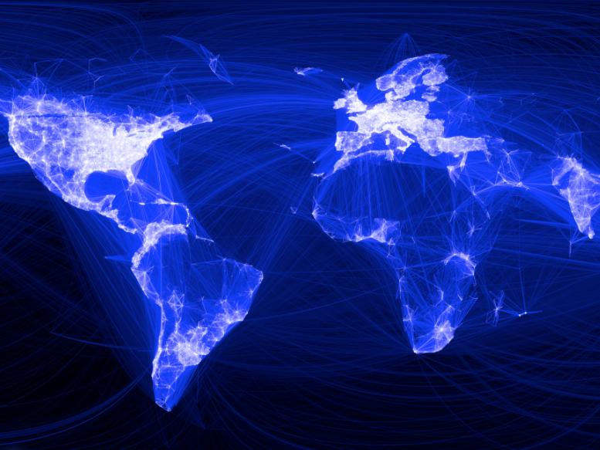
Facebook User Behavior Analytics
7200 Big-Data Sys Engr Using Scala
Chenxi Hu & Nan Yang
Spring 2016

Slide 2

Goal of the project - Usage
User recommendation for specific user id based on ti-idf analysis
search associative users given a key word based on ti-idf analysis
Use graph analysis to exclude users that already associated with then given user and present final result

Slide 3

Methodology
Data Collection
Data Analysis
Data Usage - multiuser accounts
Fetch Data from Posts
Fetch Data from Likes
Determine topics based on posts (TF-IDF)
Create user relationship graph with depth of 3 based on Likes
Calculate topic similarity and overlap of Likes graph
Group similar users
Data for Analysis
User recommendation for specific user id and search associative users given a key word
Start from a specific user

Slide 4
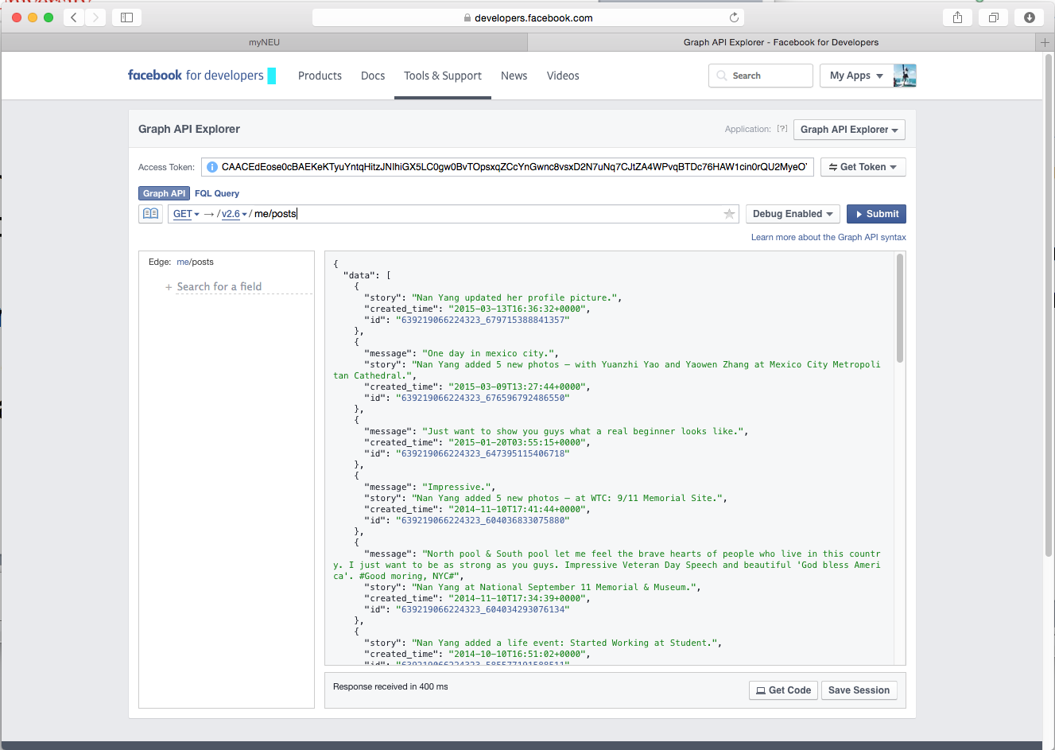
Data sources
Fetching timeline data of users from Facebook Developer API
Whole timeline Facebook posts is saved as a single text document
Graph of each user’s Likes Relationship is saved as Graph database.

Slide 5

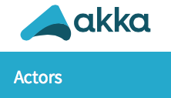
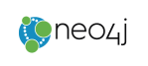
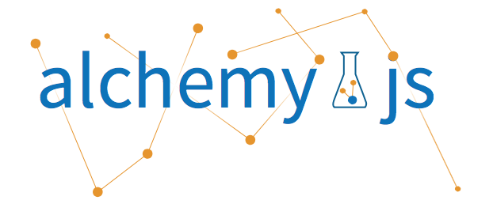
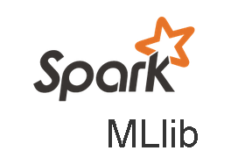


Tools involved
Function | Tools
Data Source | Facebook Developer API
Data fetching | Akka Actor
Graph | Analytics tools: Neo4j
 | Visualization: Alchemy.js
TF-IDF Analytics | Spark Mlib
 | Spark
UI | Play Framework

Slide 6
TF IDF
Term frequency and inverse document frequency
tf = single word frequency in a document / frequency of word with most occurrence
idf = Log(numbers of documents / numbers of documents containing the given word)
Tf-idf = tf * idf

Slide 7
Training a TF-IDF model
HashingTF transform each tokenized document into vector representation, map hash value of each token to vector of term frequency.
Train a NaiveBayes Model to predict the group a given user belongs to.

Slide 8
Training a TF-IDF model
Recommend users for a given user by calculating similarity between vector representation of users.
cosineSimi = SparseVector_A.dot(SparseVector_B) / norm(SparseVector_A) * norm(SparseVector_B)

Slide 9
Graph Analytics
Create Graph def createGraph(id:String, name:String, fbClient: DefaultFacebookClient): Unit
Iterate users based on Likes Relationship from StartNode and create graph database with n depth of layers by calling recursive function
Get common likes def findSimilarity(originalId:String, targetId:String) : Int
Use Cypher query get common likes between one user and a customer users Like graph
Get all notes in database def getAllNodes
Use Cypher query to get whole graph nodes and relationships

Slide 10
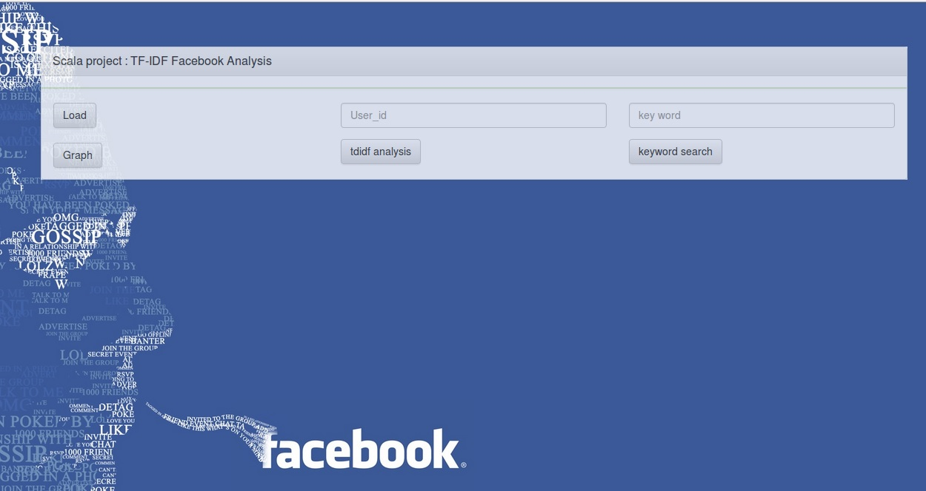
UI design

Slide 11
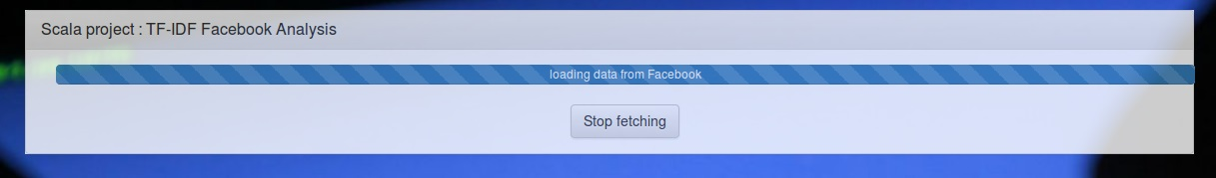
Data fetching

Slide 12
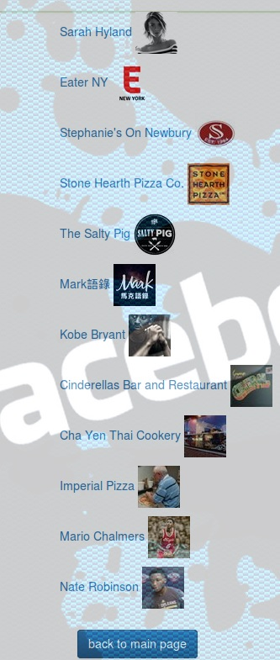
Recommend users given user id

Slide 13
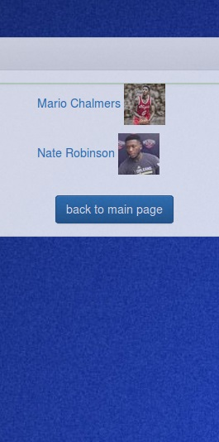
Search users based on keyword

Slide 14
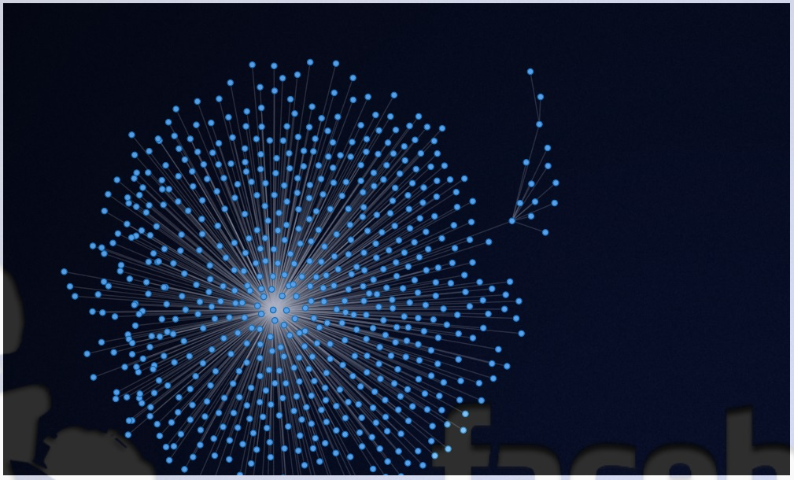
Graph Visualization

Slide 15
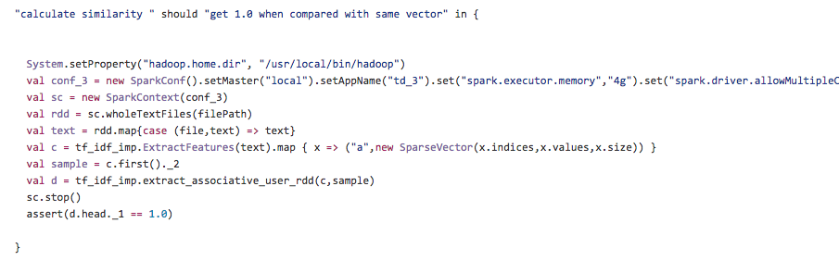
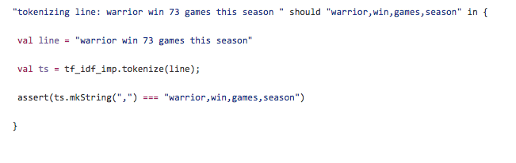
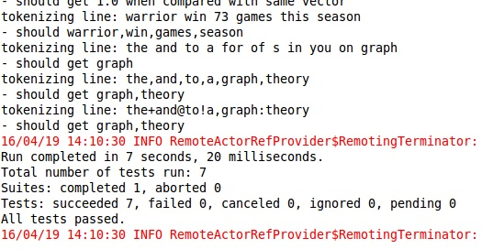
Test cases
7 test cases created to verify the result.

Slide 16

Milestones
3.23 – 3.29 Fetch Data from Facebook
3.30 – 4.05 TF-IDF analysis
4.06 – 4.12 Build Graph
4.13 – 4.19 UI design and Extended Analysis based on graph and tf-idf

Slide 17
Acceptance Criteria
In TD-IDF analysis, words with high frequency in all documents should be weighted as 0.
Accuracy of NaiveBayesModel should be greater than 0.7

Slide 18
Thank you
for any advice and suggestion.

